Slide 1
CX002-3-3
Introduction to Web Programming
Cascading Style Sheet (CSS)

Slide 2
Topic & Structure of the lesson
Introduction
Inline Styles
Embedded Style Sheets
Linking External Style Sheets
Conflicting Styles
HTML Selectors
Class Selectors
W3C CSS Validation Service
Web Resources

Slide 3
Learning Outcomes
At the end of the module, your should be
able to:
Control the appearance of a Web site by creating style sheets.
Use a style sheet to give all the pages of a Web site the same look and feel.
Use the class attribute to apply styles.
Specify the precise font, size, color and other properties of displayed text.
Specify element backgrounds and colors.
Understand the box model and how to control the margins, borders and padding.
Use style sheets to separate presentation from content.

Slide 4
Key Terms you must be able to use
If you have mastered this topic, you should
be able to use the following terms correctly
in your assignments and exams:
CSS
  Cascading Style Sheet

Slide 5
Introduction
Cascading Style Sheets (CSS)
  Separation of structure from presentation
a style sheet is a document that contains instructions that define how to display HTML elements in a Web page.
These instructions are called styles.
An external style sheet typically has the .css file extension.
3 types
  Inline
  Embedded
  External

Slide 6
Inline Styles
Declare an individual element’s format
  Attribute style
  CSS property
  Followed by a colon and a value
Inline style is a one-time style instruction placed in an individual HTML tag.
However, using inline CSS means that you are not taking advantage of the true powers of CSS, and it means that you are not separating content from presentation.
<p style="font-size: 20pt; color: #0000ff">

Slide 7
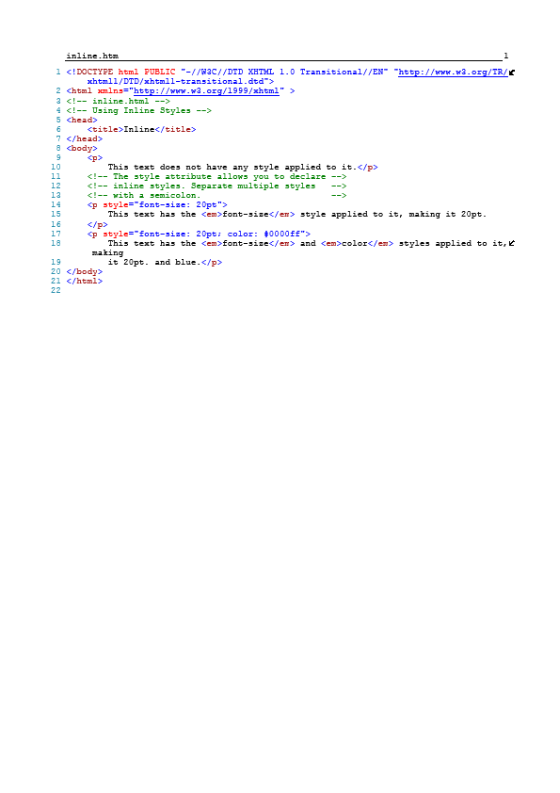
Inline Styles

Slide 8
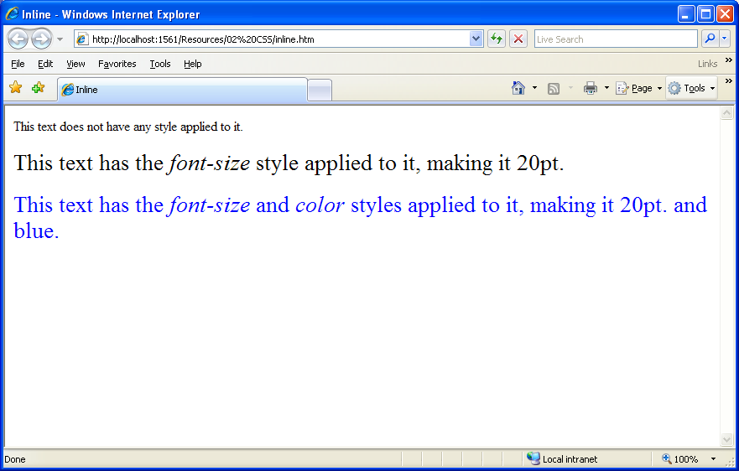
Inline Styles

Slide 9
Embedded Style Sheets
Embed an entire CSS document in an XHTML document’s head section
  Multipurpose Internet Mail Extensions (MIME) type
    Describes a file’s content
  Property background-color
    Specifies the background color
  Property font-family
    Specifies the name of the font to use
  Property font-size
    Specifies a 14-point font
it only affects the style of the page on which it is written

Slide 10
Embedded Style Sheets
<head>
<title>Style Sheets</title>
<!-- this begins the style sheet section -->
<style type = "text/css">
em { background-color: #8000ff; color: white }
h1 { font-family: arial, sans-serif }
p { font-size: 14pt }
.special { color: blue }
</style>
</head>

Slide 11
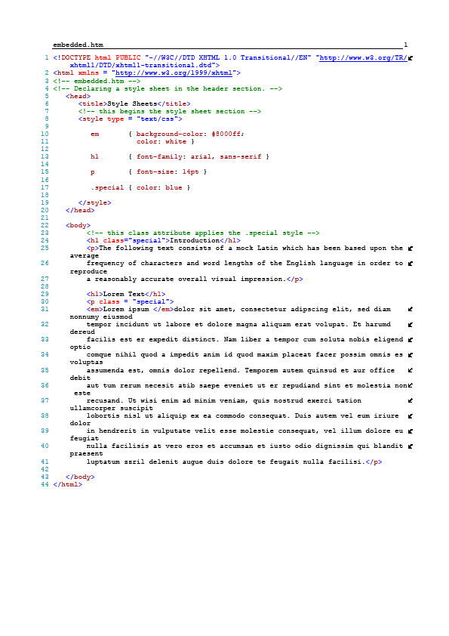
Embedded Style Sheets

Slide 12
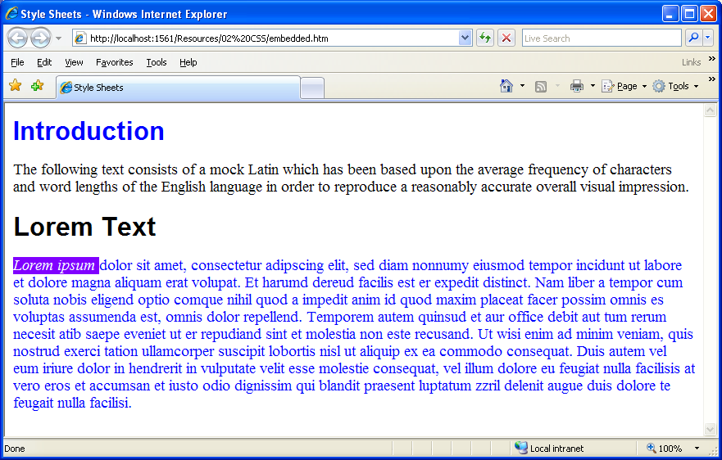
Embedded Style Sheets

Slide 13
Linking External Style Sheets
External style sheets
  Can provide uniform look and feel to entire site
One external style sheet can control the appearance of many Web pages.
By creating a CSS file that contains all of the style information for your website, you can:
  Maintain a consistent look across all pages that link to the style sheet.
  Easily update the look of all pages by changing the values in one file.
  Make your pages much smaller and quicker to download, because all of the style information has been removed to one file.

Slide 14
Linking External Style Sheets
Each page must link to the style sheet using the <link> tag.
The <link> tag goes inside the head section:
<link href="stylesheet.css" rel="stylesheet" type="text/css" />

Slide 15

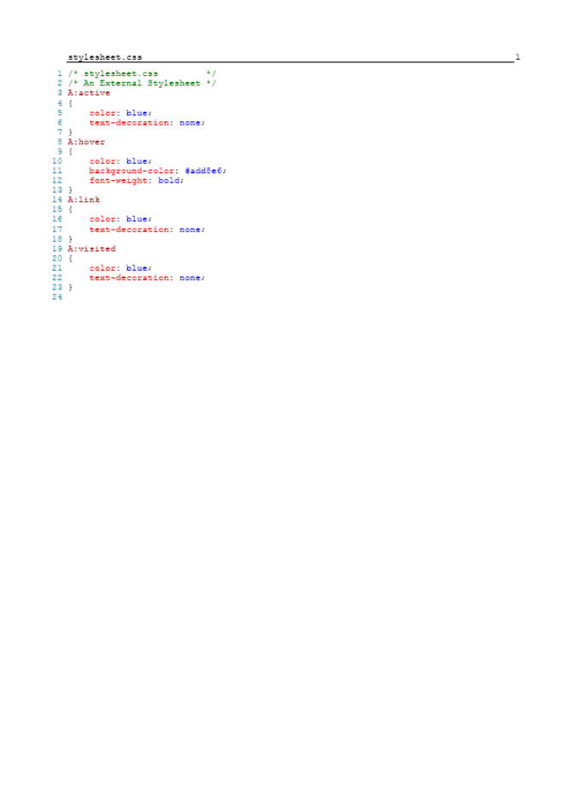
Linking External Style Sheets

Slide 16
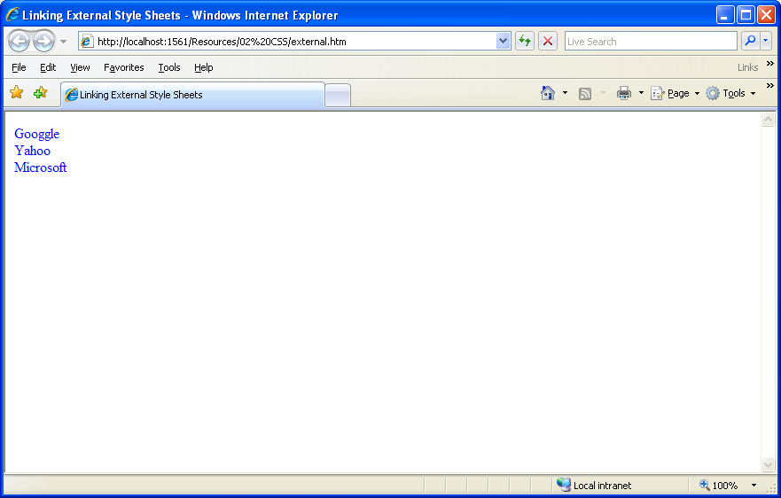
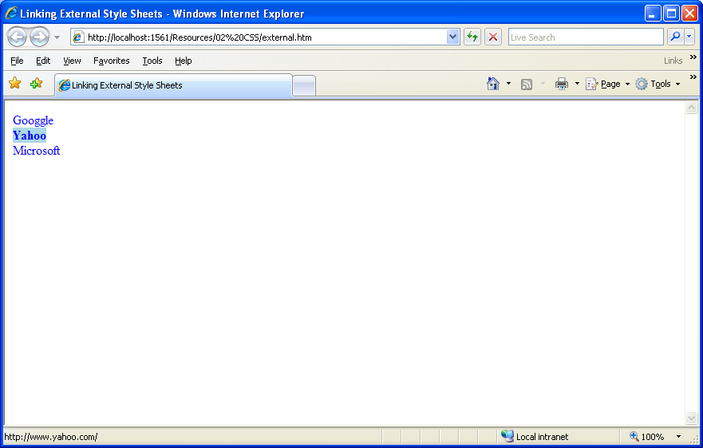
Linking External Style Sheets

Slide 17
Conflicting Styles
You could use any or all of these types of styles in a single HTML document.
If multiple style instructions exist, they will “cascade” into a single set of instructions, with some instructions taking priority over others.
This list describes the priority
  Inline Style (affects single HTML element; overrides all other style instructions)
  Embedded Style Sheet (affects one HTML document; overrides external style sheet)
  External Style Sheet (affects multiple documents, overridden by #1 and #2)
  Browser default

Slide 18
Conflicting Styles
Some other points to keep in mind:
If two styles are applied to the same text, the browser displays all attributes of both styles unless specific attributes conflict.
If attributes from two styles applied to the same text conflict, the browser displays the attribute of the innermost style (the style closest to the text itself).
HTML formatting will override any CSS formatting.
Again, please understand that different browsers may implement CSS differently. It is very important to test your Web pages in a variety of browsers to make sure your pages display correctly.

Slide 19
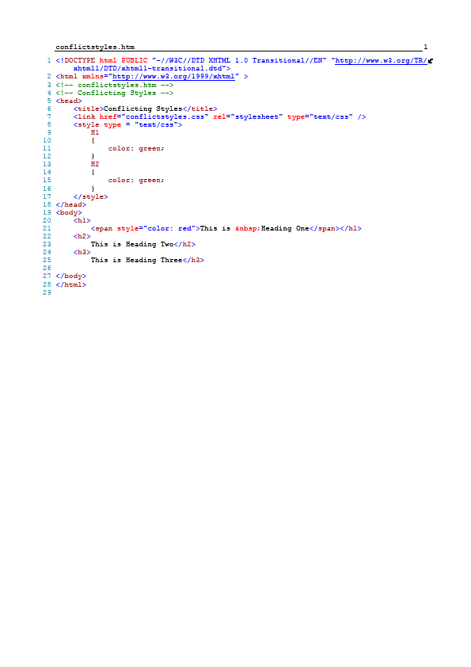

Conflicting Styles

Slide 20
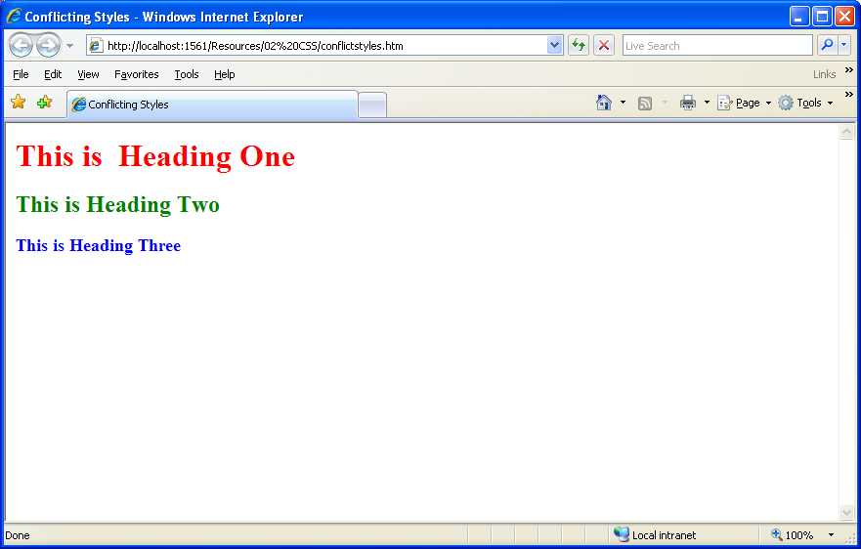
Conflicting Styles

Slide 21
HTML Selectors
HTML selectors are the text part of a HTML tag and are used to define the behavior of the specific HTML tag.
For example; H1 is the selector for <H1> tag.
Although HTML tag and the selector appear to be identical, they are not the same.
The HTML selector is used to control the behavior of its specific HTML tag.
h1 { font-family: arial, sans-serif }
p { font-size: 14pt }

Slide 22
Class Selectors
Class selectors are selectors that you create from scratch. They can be applied to any HTML tag.
Can be applied to any HTML tag
.userDefineName { font-size: 14pt; color: blue; }
<p class="userDefineName">Do Re Mi</p>

Slide 23
W3C CSS Validation Service
Validates external CSS documents
Ensures that style sheets are syntactically correct
http://jigsaw.w3.org/css-validator/

Slide 24
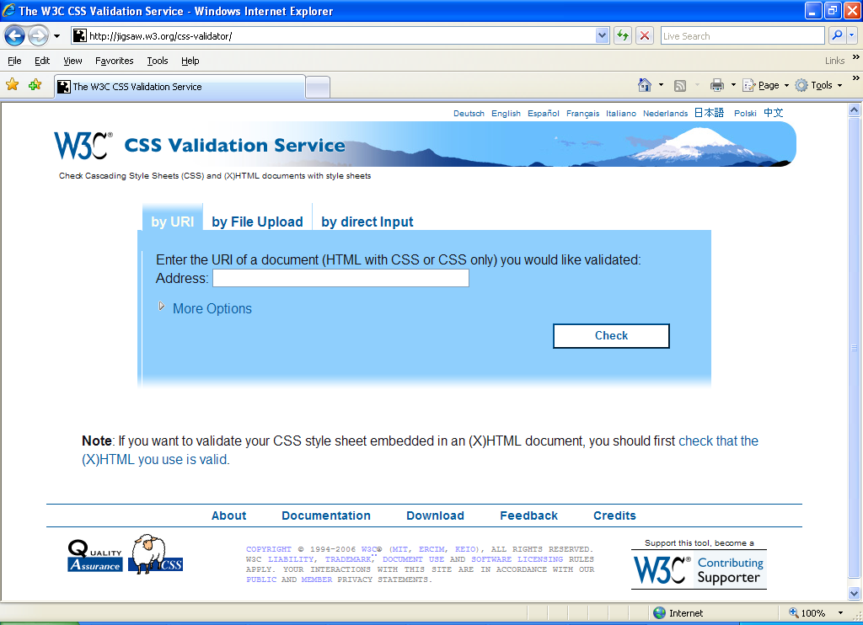
W3C CSS Validation Service

Slide 25
Web Resources
http://www.w3.org/TR/css3-roadmap
http://jigsaw.w3.org/css-validator/

Slide 26
Question and Answer Session
Q & A

Slide 27
Next Session
Topic and Structure of next session
ASP.NET

